Slide 1


MUBI Platform Database Project
Batalan Vlad
Database Engineer Intern
Notes:
Chapter Intro Slide (version C)
This slide should be used at the beginning of each “chapter” of your presentation (as introduced in the Agenda slide) to keep the audience aware of their place in the story and to help break things up. Change the text and chapter number accordingly. If you do not need a sub-head (the smaller text), delete it. Use different backgrounds for different chapter titles, try not to repeat a background.
Very short presentations (< ~10 slides) may not need Chapter Intro Slides.
There are multiple versions of this template with various white and black background images starting on slide 10.

Slide 2

Agenda
Choosing a dataset
Choosing a good engine for data storage
The normalized structure of the tables
Choosing a good etl tool
Before starting with the ETL
Talend jobs
Choosing a proper bi tool
Before creating the reports
Tableau reports
Notes:
Agenda
General Template Guidance: Information to help you make good presentations.
Standard / Static Slides: Some key Endava slides/lockups that, in general, should only be modified by marketing.
Template Slides: A selection of template slides for use in Endava presentations.
Larger Format Template Slides: Template slides with larger content.
Icon Library: A selection of hundreds of icons to use in Endava presentations.

Slide 3

1
MUBI Platform
Choosing a Dataset
Notes:
Chapter Intro Slide (version P)
This slide should be used at the beginning of each “chapter” of your presentation (as introduced in the Agenda slide) to keep the audience aware of their place in the story and to help break things up. Change the text and chapter number accordingly. If you do not need a sub-head (the smaller text), delete it. Use different backgrounds for different chapter titles, try not to repeat a background.
Very short presentations (< ~10 slides) may not need Chapter Intro Slides.
There are multiple versions of this template with various white and black background images starting on slide 10.

Slide 4

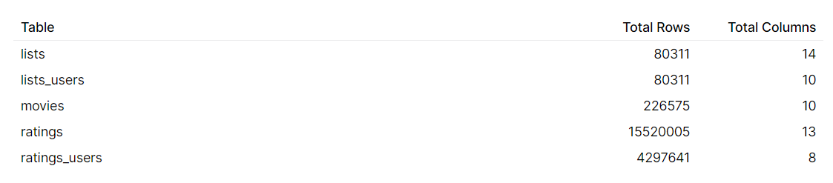
1
Choosing a Dataset
MUBI - "Netflix for art lovers"
The dataset was found on Kaggle:
https://www.kaggle.com/clementmsika/mubi-sqlite-database-for-movie-lovers
The data was collected by Clément Msika using the MUBI API.
Notes:
Standard text slide (version 5)
Creating visual differences in text-heavy pages keeps the audience interested and engaged.
Using bold and highlighted coloured text draws the reader into the important part of the text. Use this sparing throughout the text, if it is used too much, the page becomes busy, it loses its’ meaning.
Varying the length of the paragraphs as well as using bulleted and numeric lists help with keeping the reader engaged. Lists help to “skim” the information on the page and allow the audience to absorb a just the key information.

Slide 5
1
Choosing a Dataset
Problems with the dataset:
Table data is not normalized
The“movies” table has attributes that are not atomic: “director_id”, “director_name” and “director_url”.
Both “lists_users” and “ratings” tables contain user data that must be stored in a single table called “users”.
The collumns are not atomic (the elements are separated by comma), the .csv file cannot be reformated such that it can be recognized
I used the SQLite format of the data.
The number of rows of the "ratings" is too big
It contains aproximative 15.000.000 rows.
Notes:
Standard text slide (version 5)
Creating visual differences in text-heavy pages keeps the audience interested and engaged.
Using bold and highlighted coloured text draws the reader into the important part of the text. Use this sparing throughout the text, if it is used too much, the page becomes busy, it loses its’ meaning.
Varying the length of the paragraphs as well as using bulleted and numeric lists help with keeping the reader engaged. Lists help to “skim” the information on the page and allow the audience to absorb a just the key information.

Slide 6
2
MUBI Platform
Choosing a good engine for data storage
Notes:
Chapter Intro Slide (version N)
This slide should be used at the beginning of each “chapter” of your presentation (as introduced in the Agenda slide) to keep the audience aware of their place in the story and to help break things up. Change the text and chapter number accordingly. If you do not need a sub-head (the smaller text), delete it. Use different backgrounds for different chapter titles, try not to repeat a background.
Very short presentations (< ~10 slides) may not need Chapter Intro Slides.
There are multiple versions of this template with various white and black background images starting on slide 10.

Slide 7

2
Choosing a good engine for data storage
PostgreSQL over SQLite
Need a server to run
Multiple data types
Less portable, using sql code for logical export.
It does support user multiaccess.
Server-side scripts: PL/PGSQL
Embedded, Serverless.
Supports only 5 data types: (NULL, Integer, Real, Text, Blob).
Very portable (the main reason for importing the data from Kaggle in Sqlite format).
Does not support multiaccess to more users.
It is serverless, so it does not support server-side scripts.
.
Notes:
Standard text slide (version 5)
Creating visual differences in text-heavy pages keeps the audience interested and engaged.
Using bold and highlighted coloured text draws the reader into the important part of the text. Use this sparing throughout the text, if it is used too much, the page becomes busy, it loses its’ meaning.
Varying the length of the paragraphs as well as using bulleted and numeric lists help with keeping the reader engaged. Lists help to “skim” the information on the page and allow the audience to absorb a just the key information.

Slide 8


2
Choosing a good engine for data storage
PostgreSQL
After the analysis, the PostgreSQL engine was chosen as the main engine for the chosen dataset.
The fact that Talend do not recognize automatically SQLite has also contributed to this choice.
For fast migration of the raw data from SQLite to PostgreSQL the DBeaver tool was used.
Notes:
Standard text slide (version 5)
Creating visual differences in text-heavy pages keeps the audience interested and engaged.
Using bold and highlighted coloured text draws the reader into the important part of the text. Use this sparing throughout the text, if it is used too much, the page becomes busy, it loses its’ meaning.
Varying the length of the paragraphs as well as using bulleted and numeric lists help with keeping the reader engaged. Lists help to “skim” the information on the page and allow the audience to absorb a just the key information.

Slide 9
3
MUBI Platform
The normalized structure of the tables
Notes:
Chapter Intro Slide (version N)
This slide should be used at the beginning of each “chapter” of your presentation (as introduced in the Agenda slide) to keep the audience aware of their place in the story and to help break things up. Change the text and chapter number accordingly. If you do not need a sub-head (the smaller text), delete it. Use different backgrounds for different chapter titles, try not to repeat a background.
Very short presentations (< ~10 slides) may not need Chapter Intro Slides.
There are multiple versions of this template with various white and black background images starting on slide 10.

Slide 10
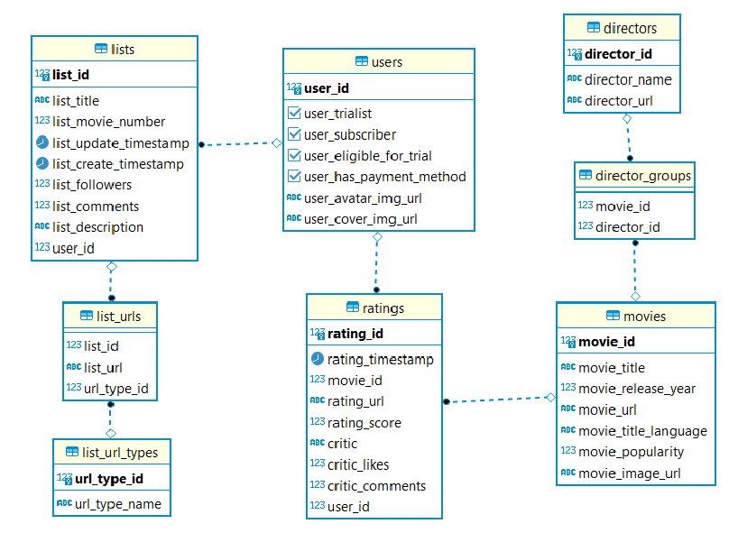
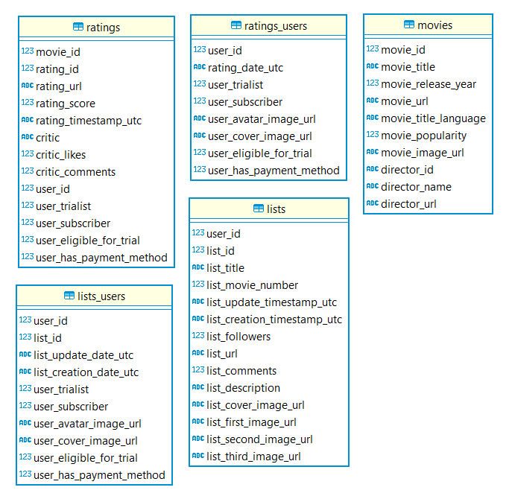
3
The normalized structure of the tables
The raw Dataset
The normalized Dataset
Notes:
Standard text slide (version 5)
Creating visual differences in text-heavy pages keeps the audience interested and engaged.
Using bold and highlighted coloured text draws the reader into the important part of the text. Use this sparing throughout the text, if it is used too much, the page becomes busy, it loses its’ meaning.
Varying the length of the paragraphs as well as using bulleted and numeric lists help with keeping the reader engaged. Lists help to “skim” the information on the page and allow the audience to absorb a just the key information.

Slide 11
4
MUBI Platform
Choosing a good ETL tool
Notes:
Chapter Intro Slide (version N)
This slide should be used at the beginning of each “chapter” of your presentation (as introduced in the Agenda slide) to keep the audience aware of their place in the story and to help break things up. Change the text and chapter number accordingly. If you do not need a sub-head (the smaller text), delete it. Use different backgrounds for different chapter titles, try not to repeat a background.
Very short presentations (< ~10 slides) may not need Chapter Intro Slides.
There are multiple versions of this template with various white and black background images starting on slide 10.

Slide 12

4
Choosing a good ETL tool
Talend – the fittest ETL tool
Restrictions:
The "ratings" table contains a considerable volume of data which processing is time consuming.
The query execution performance (for example: joins between tables) is a characteristic that must be taken into consideration.
The chosen tool must support different source types.
In our case: PostrgreSQL database and .csv files.
Notes:
Standard text slide (version 5)
Creating visual differences in text-heavy pages keeps the audience interested and engaged.
Using bold and highlighted coloured text draws the reader into the important part of the text. Use this sparing throughout the text, if it is used too much, the page becomes busy, it loses its’ meaning.
Varying the length of the paragraphs as well as using bulleted and numeric lists help with keeping the reader engaged. Lists help to “skim” the information on the page and allow the audience to absorb a just the key information.

Slide 13
5
MUBI Platform
Before starting with the ETL
Notes:
Chapter Intro Slide (version N)
This slide should be used at the beginning of each “chapter” of your presentation (as introduced in the Agenda slide) to keep the audience aware of their place in the story and to help break things up. Change the text and chapter number accordingly. If you do not need a sub-head (the smaller text), delete it. Use different backgrounds for different chapter titles, try not to repeat a background.
Very short presentations (< ~10 slides) may not need Chapter Intro Slides.
There are multiple versions of this template with various white and black background images starting on slide 10.

Slide 14
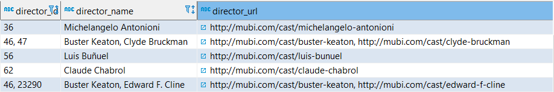
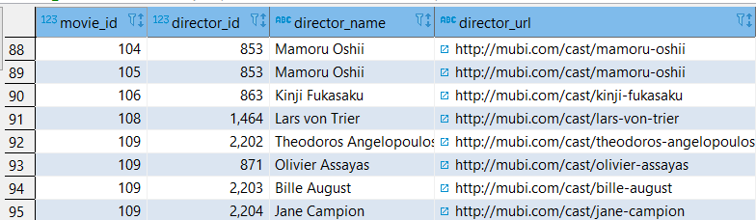
5
Before starting with the ETL
Normalizing the "movies" tables for directors
A materialized view was generated using the PL/PGSQL language which contains structured data that can be easly manipulated in Talend.
The raw information from the "movies" table:
The structure of the created view called "director_normalized_view":
Notes:
Standard text slide (version 5)
Creating visual differences in text-heavy pages keeps the audience interested and engaged.
Using bold and highlighted coloured text draws the reader into the important part of the text. Use this sparing throughout the text, if it is used too much, the page becomes busy, it loses its’ meaning.
Varying the length of the paragraphs as well as using bulleted and numeric lists help with keeping the reader engaged. Lists help to “skim” the information on the page and allow the audience to absorb a just the key information.

Slide 15
6
MUBI Platform
Talend jobs
Notes:
Chapter Intro Slide (version N)
This slide should be used at the beginning of each “chapter” of your presentation (as introduced in the Agenda slide) to keep the audience aware of their place in the story and to help break things up. Change the text and chapter number accordingly. If you do not need a sub-head (the smaller text), delete it. Use different backgrounds for different chapter titles, try not to repeat a background.
Very short presentations (< ~10 slides) may not need Chapter Intro Slides.
There are multiple versions of this template with various white and black background images starting on slide 10.

Slide 16
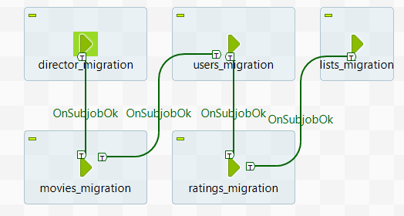
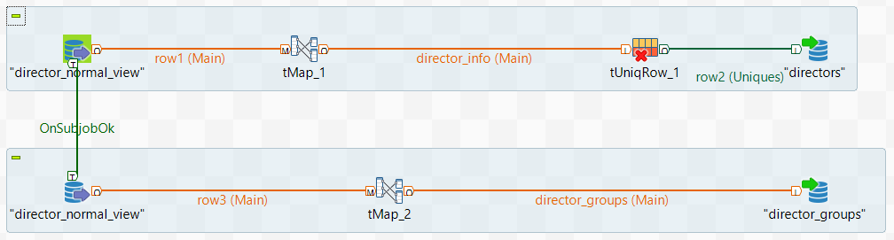
6
Talend jobs
The order of jobs is very important because these are influenced by referential constraints.
For example, if the first table that is populated with data is “director_groups”, there is a chance that there is a director_id which has no correspondent in the “directors” table or there is a movie_id with no correspondent in the "movies" table.
In "director_migration" job, the tables that are populated are "directors" and "director_groups". The source used is the view created earlier called "director_normal_view".
mubi_job_orchestrator
Director_migration
Notes:
Standard text slide (version 5)
Creating visual differences in text-heavy pages keeps the audience interested and engaged.
Using bold and highlighted coloured text draws the reader into the important part of the text. Use this sparing throughout the text, if it is used too much, the page becomes busy, it loses its’ meaning.
Varying the length of the paragraphs as well as using bulleted and numeric lists help with keeping the reader engaged. Lists help to “skim” the information on the page and allow the audience to absorb a just the key information.

Slide 17
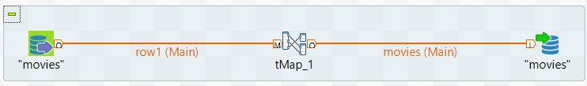
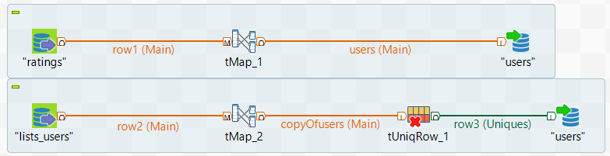
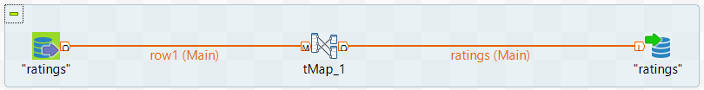
6
Talend jobs
For the next jobs, there are used simple mappings and maximum a unique row component.
Movie_migration
mubi_job_orchestrator
Users_migration
Ratings_migration
Notes:
Standard text slide (version 5)
Creating visual differences in text-heavy pages keeps the audience interested and engaged.
Using bold and highlighted coloured text draws the reader into the important part of the text. Use this sparing throughout the text, if it is used too much, the page becomes busy, it loses its’ meaning.
Varying the length of the paragraphs as well as using bulleted and numeric lists help with keeping the reader engaged. Lists help to “skim” the information on the page and allow the audience to absorb a just the key information.

Slide 18
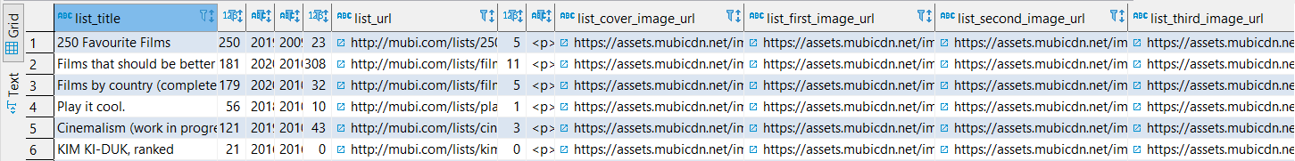
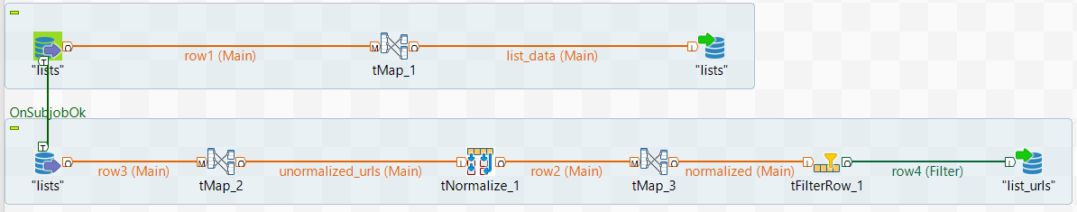
6
Talend jobs
The transformation upon "lists" table was a problematic one.
The target is to transform all the collumns that contain urls into rows, eliminating the NULLS from the table.
The Talend solution:
All the collumns are transposed into a single row using the following format:
<url>;1,<cover>;2,<first>;3,<second>;4,<third>;5
The process is conducted in the tMap_2 component
The data is then normalized after the "," delimtator.
tMap_3 splits the format <url>;<tip_url> into two different columns.
The result is stored in the "lists_urls" table.
Lists_migration
Notes:
Standard text slide (version 5)
Creating visual differences in text-heavy pages keeps the audience interested and engaged.
Using bold and highlighted coloured text draws the reader into the important part of the text. Use this sparing throughout the text, if it is used too much, the page becomes busy, it loses its’ meaning.
Varying the length of the paragraphs as well as using bulleted and numeric lists help with keeping the reader engaged. Lists help to “skim” the information on the page and allow the audience to absorb a just the key information.

Slide 19
7
MUBI Platform
Chossing a proper BI tool
Notes:
Chapter Intro Slide (version N)
This slide should be used at the beginning of each “chapter” of your presentation (as introduced in the Agenda slide) to keep the audience aware of their place in the story and to help break things up. Change the text and chapter number accordingly. If you do not need a sub-head (the smaller text), delete it. Use different backgrounds for different chapter titles, try not to repeat a background.
Very short presentations (< ~10 slides) may not need Chapter Intro Slides.
There are multiple versions of this template with various white and black background images starting on slide 10.

Slide 20

7
Choosing a proper BI tool
Tableau
In contrast to other BI tools (PowerBi), Tableau offers the possibility to create tables from SQL commands, assuring also very good query execution performance.
Tableau is an interactive tool, using a friendly UI. Furthermore, it can use data from multiple source types (many database engines, Cloud, local files in different formats).
Notes:
Standard text slide (version 5)
Creating visual differences in text-heavy pages keeps the audience interested and engaged.
Using bold and highlighted coloured text draws the reader into the important part of the text. Use this sparing throughout the text, if it is used too much, the page becomes busy, it loses its’ meaning.
Varying the length of the paragraphs as well as using bulleted and numeric lists help with keeping the reader engaged. Lists help to “skim” the information on the page and allow the audience to absorb a just the key information.

Slide 21
8
MUBI Platform
Before creating the reports
Notes:
Chapter Intro Slide (version N)
This slide should be used at the beginning of each “chapter” of your presentation (as introduced in the Agenda slide) to keep the audience aware of their place in the story and to help break things up. Change the text and chapter number accordingly. If you do not need a sub-head (the smaller text), delete it. Use different backgrounds for different chapter titles, try not to repeat a background.
Very short presentations (< ~10 slides) may not need Chapter Intro Slides.
There are multiple versions of this template with various white and black background images starting on slide 10.

Slide 22
8
Before creating the reports
A new Dataset has been added to the project
The normalized data is collected from PostgreSQL and it is completed with the data from the following dataset:
https://zenodo.org/record/1240586#.YSS1Xo4zZPZ
This new Dataset contains information about Budget and Revenue foreach movie. The link between the new Dataset and the "movies" table is made through the movie title.
Notes:
Standard text slide (version 5)
Creating visual differences in text-heavy pages keeps the audience interested and engaged.
Using bold and highlighted coloured text draws the reader into the important part of the text. Use this sparing throughout the text, if it is used too much, the page becomes busy, it loses its’ meaning.
Varying the length of the paragraphs as well as using bulleted and numeric lists help with keeping the reader engaged. Lists help to “skim” the information on the page and allow the audience to absorb a just the key information.

Slide 23
9
MUBI Platform
Tableau reports
Notes:
Chapter Intro Slide (version N)
This slide should be used at the beginning of each “chapter” of your presentation (as introduced in the Agenda slide) to keep the audience aware of their place in the story and to help break things up. Change the text and chapter number accordingly. If you do not need a sub-head (the smaller text), delete it. Use different backgrounds for different chapter titles, try not to repeat a background.
Very short presentations (< ~10 slides) may not need Chapter Intro Slides.
There are multiple versions of this template with various white and black background images starting on slide 10.

Slide 24
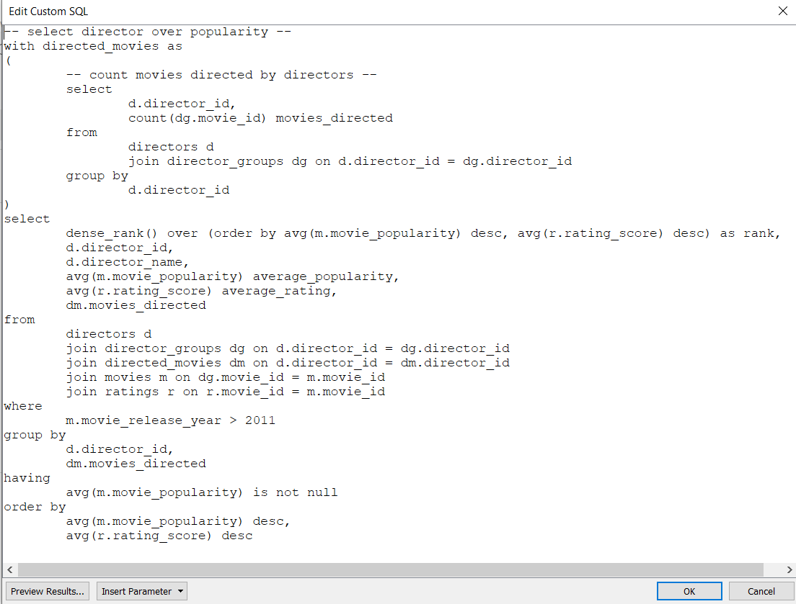
9
Tableau reports
1) Best movie directors over movies popularity in the last 10 years
For this first raport, the functionality of Tableau to create tables from SQL commands has been used.
Notes:
Standard text slide (version 5)
Creating visual differences in text-heavy pages keeps the audience interested and engaged.
Using bold and highlighted coloured text draws the reader into the important part of the text. Use this sparing throughout the text, if it is used too much, the page becomes busy, it loses its’ meaning.
Varying the length of the paragraphs as well as using bulleted and numeric lists help with keeping the reader engaged. Lists help to “skim” the information on the page and allow the audience to absorb a just the key information.

Slide 25
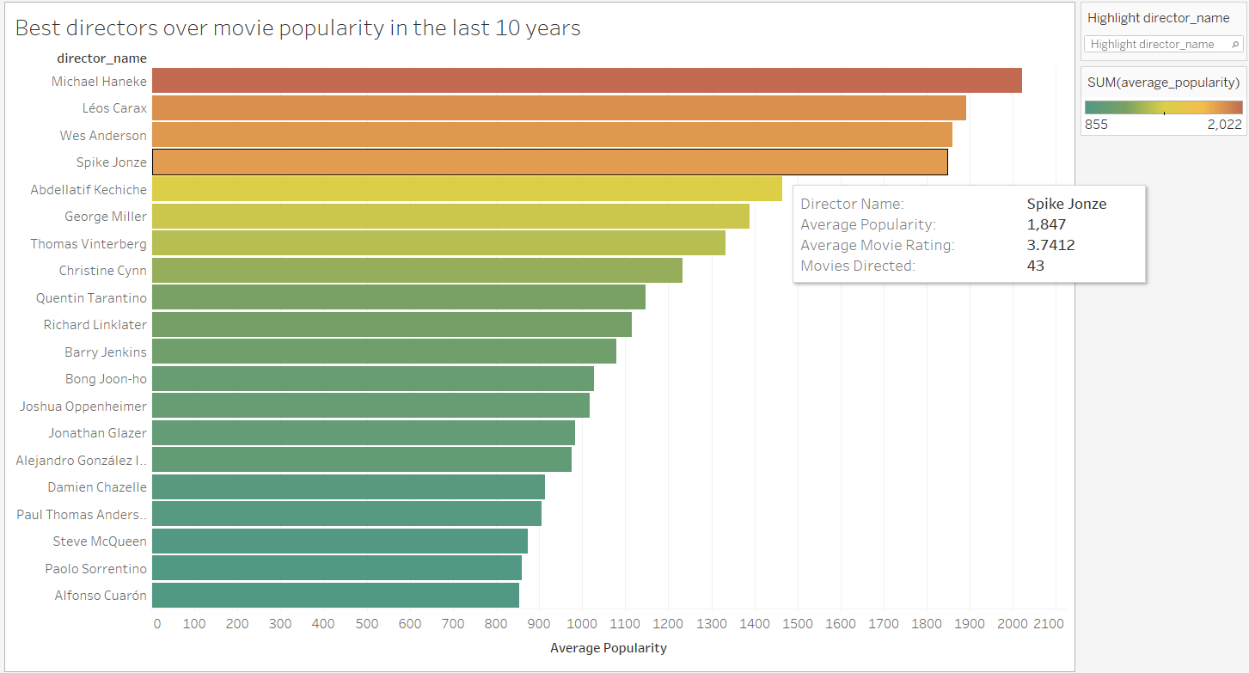
9
Tableau reports
1) Best movie directors over movies popularity in the last 10 years
Notes:
Standard text slide (version 5)
Creating visual differences in text-heavy pages keeps the audience interested and engaged.
Using bold and highlighted coloured text draws the reader into the important part of the text. Use this sparing throughout the text, if it is used too much, the page becomes busy, it loses its’ meaning.
Varying the length of the paragraphs as well as using bulleted and numeric lists help with keeping the reader engaged. Lists help to “skim” the information on the page and allow the audience to absorb a just the key information.

Slide 26
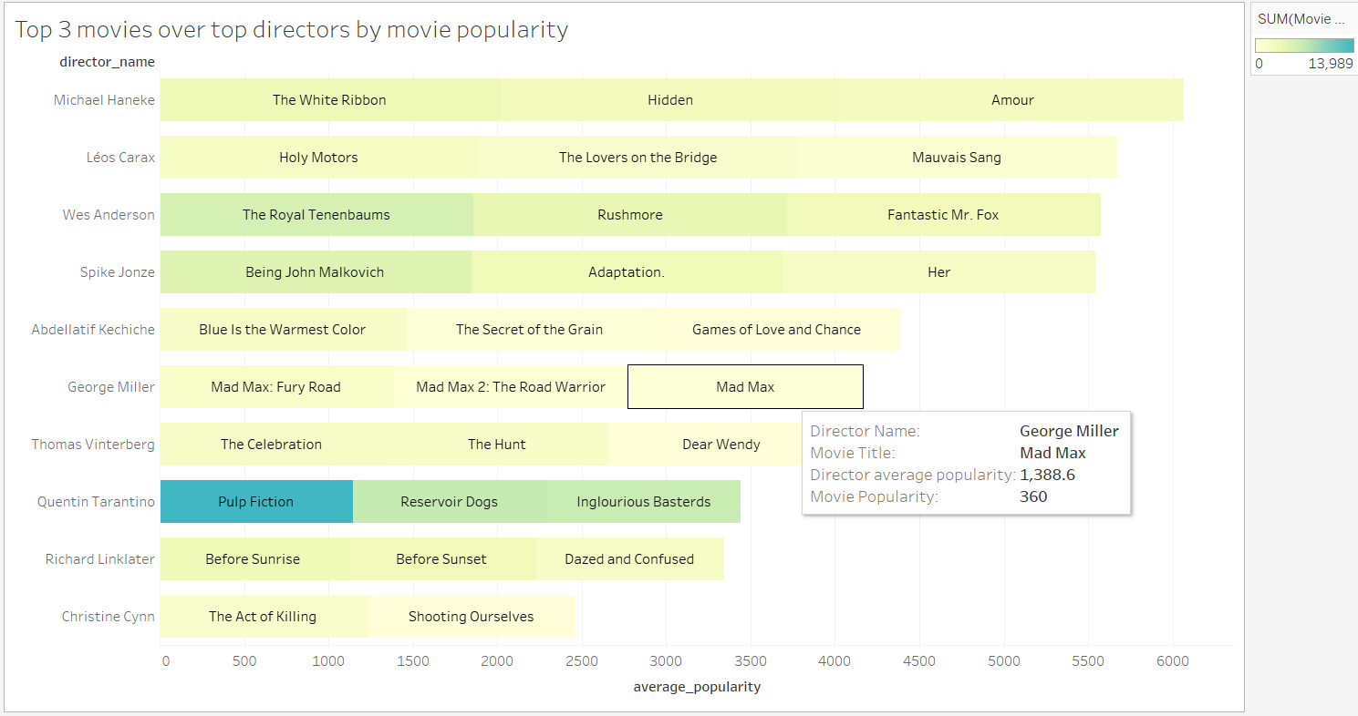
9
Tableau reports
2) Top 3 movies over popularity directed by this best directors
Notes:
Standard text slide (version 5)
Creating visual differences in text-heavy pages keeps the audience interested and engaged.
Using bold and highlighted coloured text draws the reader into the important part of the text. Use this sparing throughout the text, if it is used too much, the page becomes busy, it loses its’ meaning.
Varying the length of the paragraphs as well as using bulleted and numeric lists help with keeping the reader engaged. Lists help to “skim” the information on the page and allow the audience to absorb a just the key information.

Slide 27
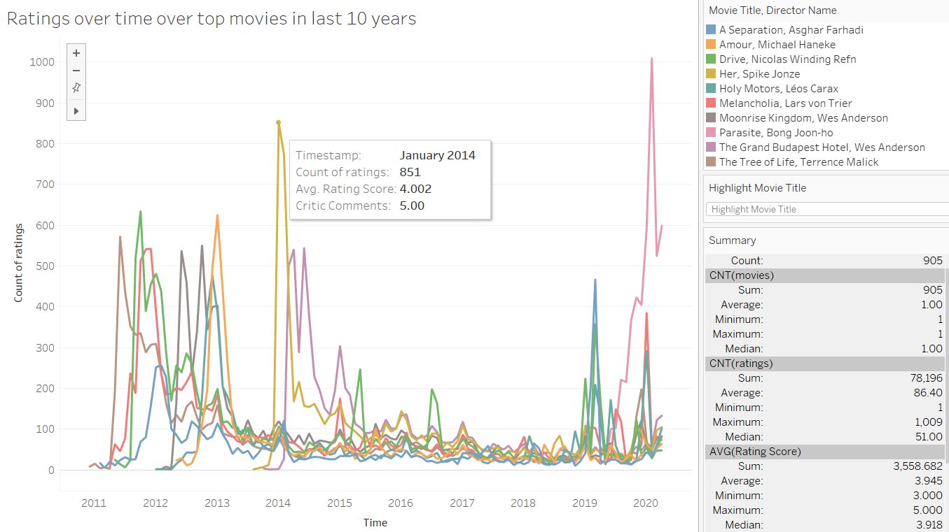
9
Tableau reports
3) Ratings over time over top movies in the last 10 years
Notes:
Standard text slide (version 5)
Creating visual differences in text-heavy pages keeps the audience interested and engaged.
Using bold and highlighted coloured text draws the reader into the important part of the text. Use this sparing throughout the text, if it is used too much, the page becomes busy, it loses its’ meaning.
Varying the length of the paragraphs as well as using bulleted and numeric lists help with keeping the reader engaged. Lists help to “skim” the information on the page and allow the audience to absorb a just the key information.

Slide 28
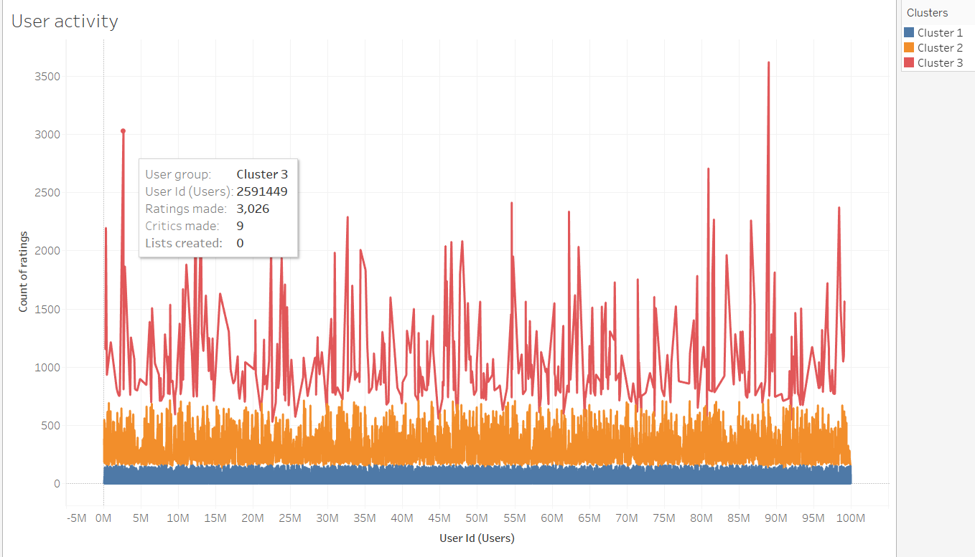
9
Tableau reports
4) User activity
Notes:
Standard text slide (version 5)
Creating visual differences in text-heavy pages keeps the audience interested and engaged.
Using bold and highlighted coloured text draws the reader into the important part of the text. Use this sparing throughout the text, if it is used too much, the page becomes busy, it loses its’ meaning.
Varying the length of the paragraphs as well as using bulleted and numeric lists help with keeping the reader engaged. Lists help to “skim” the information on the page and allow the audience to absorb a just the key information.

Slide 29
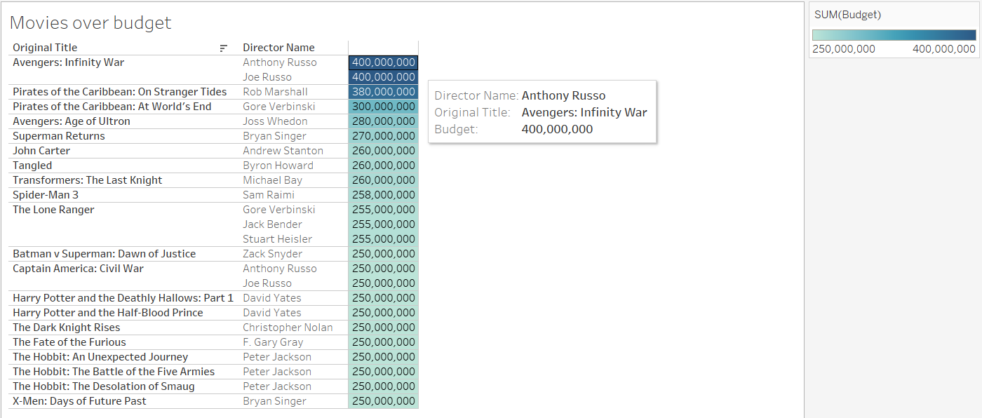
9
Tableau reports
5) Movies over budget
Notes:
Standard text slide (version 5)
Creating visual differences in text-heavy pages keeps the audience interested and engaged.
Using bold and highlighted coloured text draws the reader into the important part of the text. Use this sparing throughout the text, if it is used too much, the page becomes busy, it loses its’ meaning.
Varying the length of the paragraphs as well as using bulleted and numeric lists help with keeping the reader engaged. Lists help to “skim” the information on the page and allow the audience to absorb a just the key information.

Slide 30
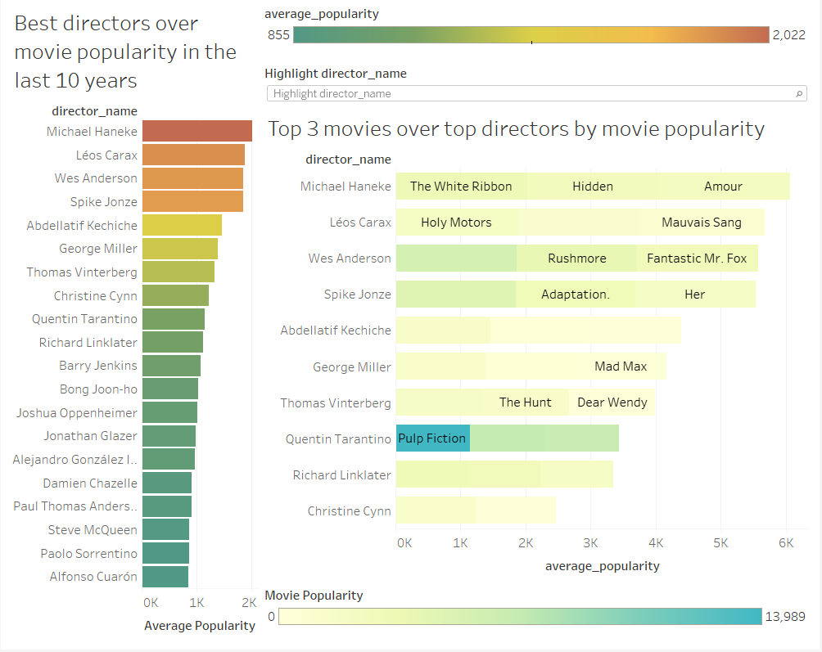
9
Tableau reports
6) Best Directors Dashboard
Notes:
Standard text slide (version 5)
Creating visual differences in text-heavy pages keeps the audience interested and engaged.
Using bold and highlighted coloured text draws the reader into the important part of the text. Use this sparing throughout the text, if it is used too much, the page becomes busy, it loses its’ meaning.
Varying the length of the paragraphs as well as using bulleted and numeric lists help with keeping the reader engaged. Lists help to “skim” the information on the page and allow the audience to absorb a just the key information.

Slide 31
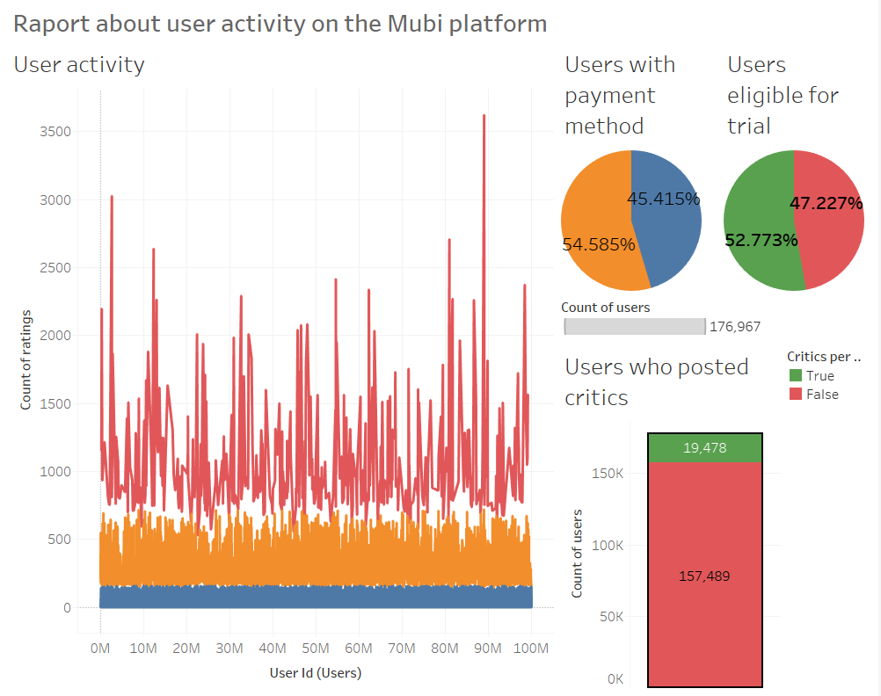
9
Tableau reports
7) User Activity Dashboard
Notes:
Standard text slide (version 5)
Creating visual differences in text-heavy pages keeps the audience interested and engaged.
Using bold and highlighted coloured text draws the reader into the important part of the text. Use this sparing throughout the text, if it is used too much, the page becomes busy, it loses its’ meaning.
Varying the length of the paragraphs as well as using bulleted and numeric lists help with keeping the reader engaged. Lists help to “skim” the information on the page and allow the audience to absorb a just the key information.

Slide 32
Useful links
https://www.kaggle.com/clementmsika/mubi-sqlite-database-for-movie-lovers
https://zenodo.org/record/1240586#.YSS1Xo4zZPZ
https://www.postgresql.org/docs/13/index.html
https://www.sqlite.org/docs.html
https://www.tableau.com/
https://help.talend.com/r/MW~bv2NtBd_sCQPsRNN2pA/lCqoKBO1L5I3HJrhQ49C8g
https://dbeaver.com/docs/wiki/
Notes:
Agenda
General Template Guidance: Information to help you make good presentations.
Standard / Static Slides: Some key Endava slides/lockups that, in general, should only be modified by marketing.
Template Slides: A selection of template slides for use in Endava presentations.
Larger Format Template Slides: Template slides with larger content.
Icon Library: A selection of hundreds of icons to use in Endava presentations.

